Slide 1
Angular.IO
26 Apr 18 | Start
17 May 18 | 3:53
Appendix
Online

Slide 2
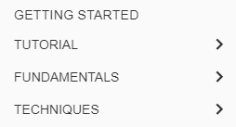
Angular.IO
Ch | Date
1 | 05 May 18
2
3
4
https://angular.io/docs

Slide 3
What is Angular?
Angular is a platform that makes it easy to build applications with the web.
Angular combines
declarative templates
dependency injection
end to end tooling, and
integrated best practices
to solve development challenges.
Angular empowers developers to build applications that live on the
Web
Mobile
the desktop

Slide 4
Assumptions
This documentation assumes that you are already familiar with JavaScript, and some of the tools from the latest standards such as
Classes
Modules
The code samples are written using TypeScript.
Most Angular code can be written with just the latest JavaScript
using types for dependency injection
using decorators for metadata

Slide 5
Getting Started
1
QuickStart
Project File Review

Slide 6
QuickStart
Good tools make application development quicker and easier to maintain than if you did everything by hand.
The Angular CLI is a command line interface tool that can
create a project
add files
perform a variety of ongoing development tasks such as
Testing
Bundling
Deployment
The goal in this guide is to build and run a simple Angular application in TypeScript, using the Angular CLI while adhering to the Style Guide recommendations that benefit every Angular project.
By the end of the chapter, you'll have a basic understanding of development with the CLI and a foundation for both these documentation samples and for real world applications.

Slide 7

Step 1
You need to set up your development environment before you can do anything.
Install Node.js and npm if they are not already on your machine.
Verify that you are running at least node 6.9.x and npm 3.x.x by running node -v and npm -v in a terminal/console window.
Older versions produce errors, but newer versions are fine.
Then install the Angular CLI globally.

Slide 8

Step 2
Open a terminal window.
Generate a new project and skeleton application by running the following commands:
The Angular CLI installs the
necessary npm packages
creates the project files
populates the project with a simple default app.
This can take some time.
Patience, please. It takes time to set up a new project; most of it is spent installing npm packages.

Slide 9
NOTE
You can add pre-packaged functionality to a new project by using the ng add command.
The ng add command transforms a project by applying the schematics in the specified package.
For more information, see the Angular CLI documentation.
Angular Material provides schematics for typical app layouts.
See the Angular Material documentation for details.

Slide 10

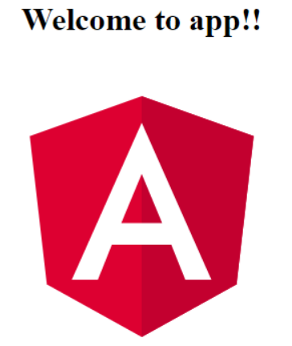
Step 3
Serve the application
Go to the project directory and launch the server.
The ng serve command
launches the server,
watches your files
rebuilds the app as you make changes to those files.
Using the --open (or just -o) option will automatically open your browser on http://localhost:4200/.
Your app greets you with a message:

Slide 11
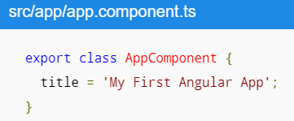
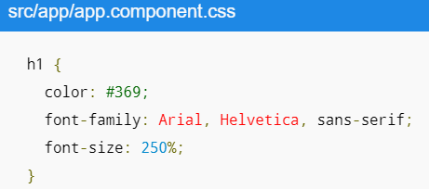

Step 4
Edit your first Angular component
The CLI created the first Angular component for you. This is the root component and it is named app-root.
Open the component file and change the title property from Welcome to app!! to Welcome to My First Angular App!!:
The browser reloads automatically with the revised title. That's nice, but it could look better.
Open src/app/app.component.css and give the component some style.

Slide 12
What's next?
That's about all you'd expect to do in a "Hello, World" app.
You're ready to take the Tour of Heroes Tutorial and build a small application that demonstrates the great things you can build with Angular.
Or you can stick around a bit longer to learn about the files in your brand new project.

Slide 13
Project File Review
An Angular CLI project is the foundation for both
quick experiments
enterprise solutions
The first file you should check out is README.md.
It has some basic information on how to use CLI commands.
Whenever you want to know more about how Angular CLI works make sure to visit the Angular CLI repository and Wiki.

Slide 14
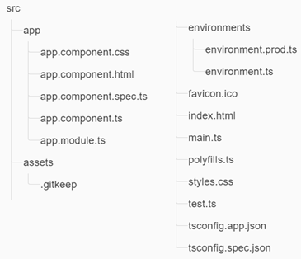
The src Folder
Your app lives in the src folder.
All Angular
Components
Templates
Styles
Images
anything else your app needs go here
Any files outside of this folder are meant to support building your app.

Slide 15
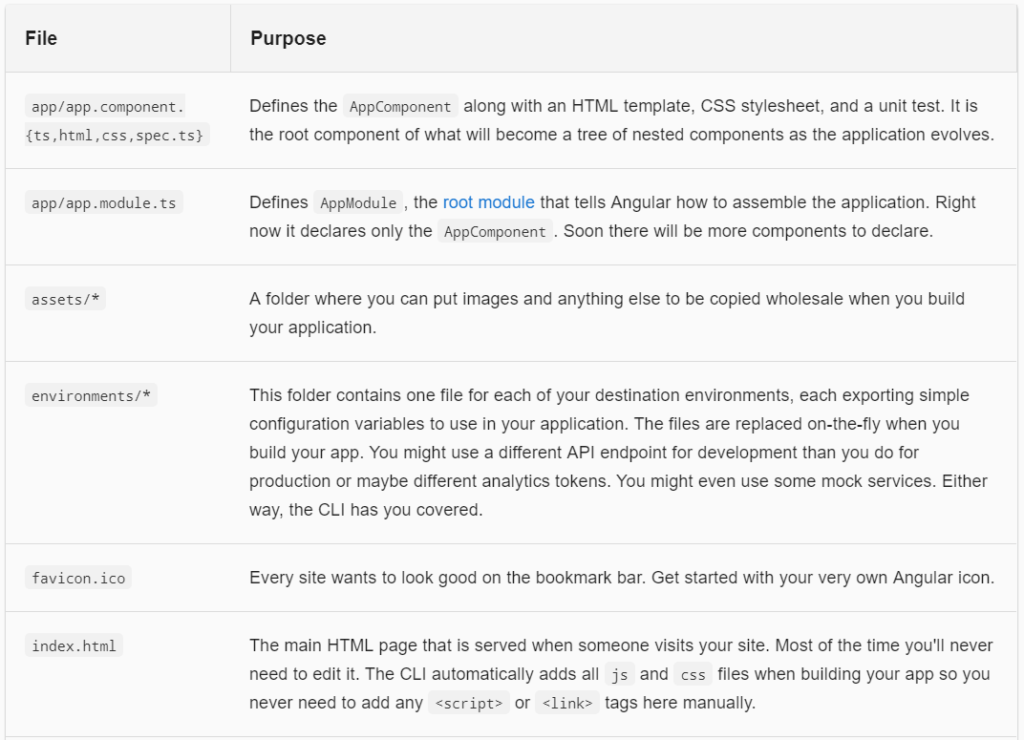
File & Purpose

Slide 16
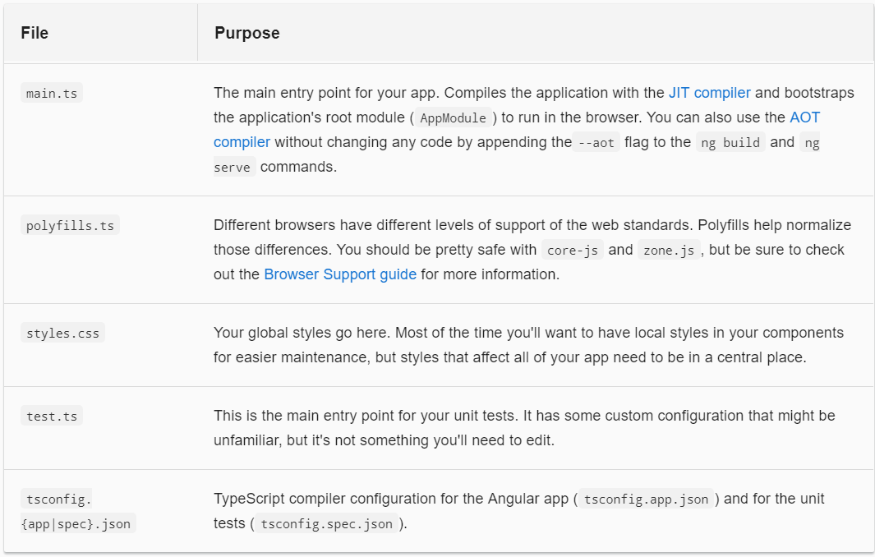
File & Purpose |

Slide 17
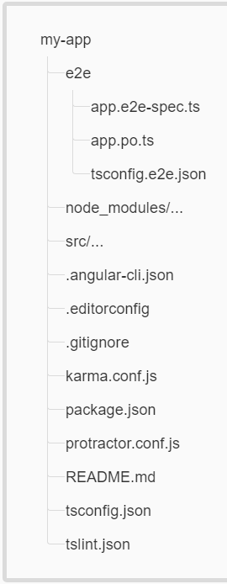
The root Folder
The src/ folder is just one of the items inside the project's root folder.
Other files help you build, test, maintain, document, and deploy the app.
These files go in the root folder next to src/.

Slide 18
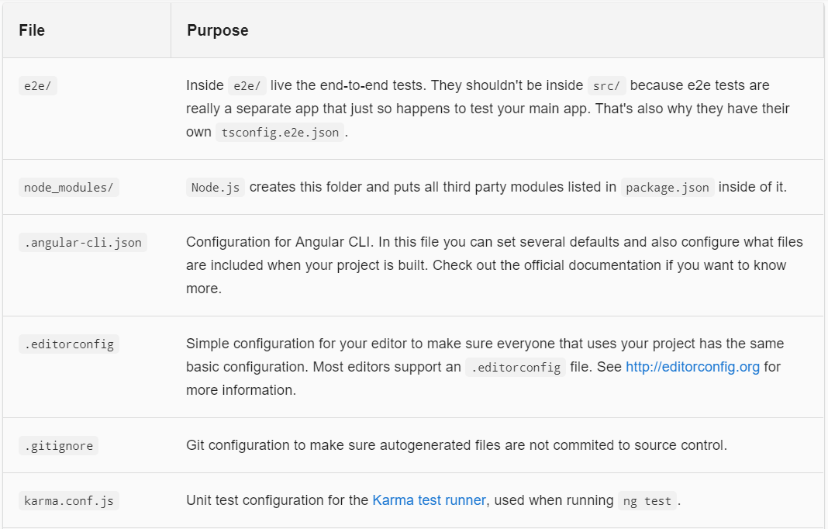
File & Purpose

Slide 19
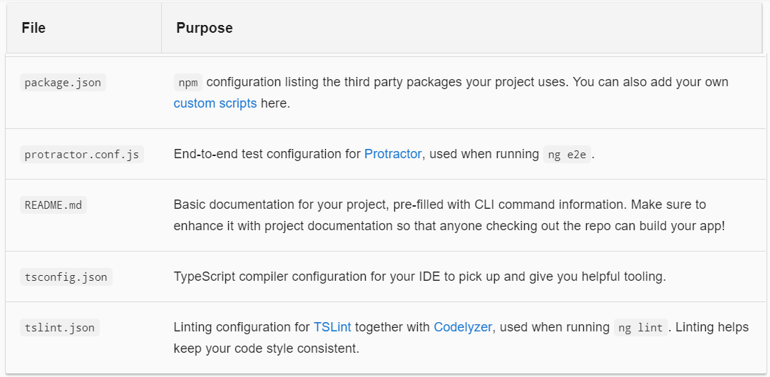
File & Purpose |

Slide 20
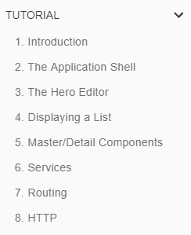
2
Tutorial

Slide 21
Introduction
Tour of Heroes
The Tour of Heroes tutorial covers the fundamentals of Angular.
In this tutorial you will build an app that helps a staffing agency manage its stable of heroes.
This basic app has many of the features you'd expect to find in a data-driven application.
It acquires and displays a list of heroes, edits a selected hero's detail, and navigates among different views of heroic data.

Slide 22
Agenda
By the end of the tutorial you will be able to do the following:
Use built-in Angular directives to show and hide elements and display lists of hero data.
Create Angular components to display hero details and show an array of heroes.
Use one-way data binding for read-only data.
Add editable fields to update a model with two-way data binding.
Bind component methods to user events, like keystrokes and clicks.
Enable users to select a hero from a master list and edit that hero in the details view.
Format data with pipes.
Create a shared service to assemble the heroes.
Use routing to navigate among different views and their components.

Slide 23
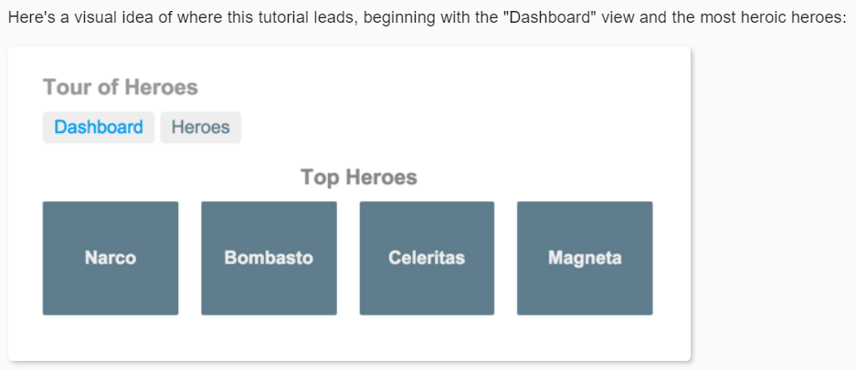
What you’ll build

Slide 24
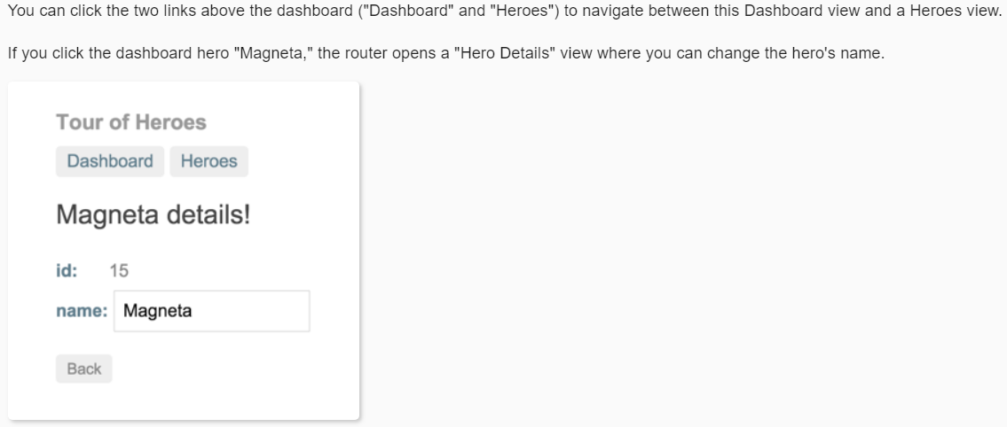
What you’ll build |

Slide 25
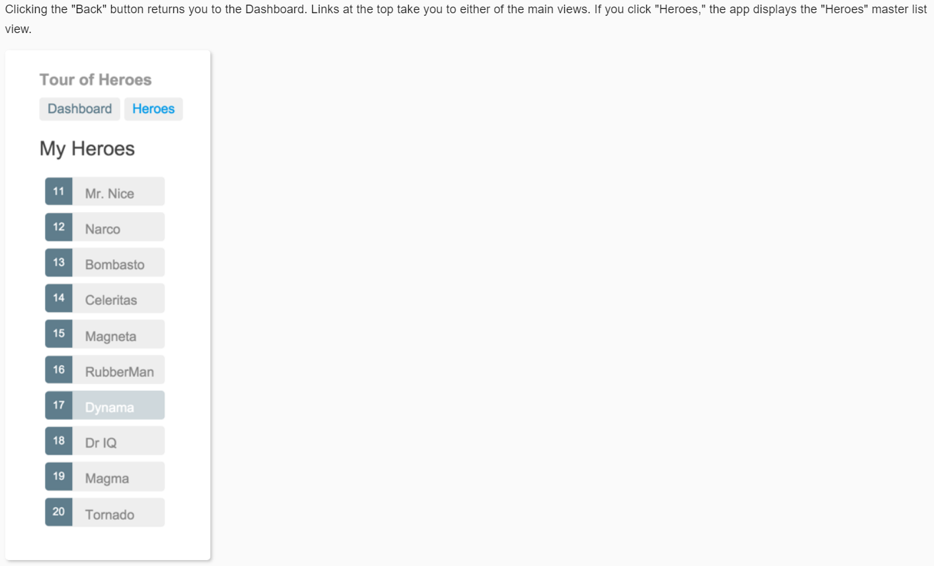
What you’ll build ||

Slide 26
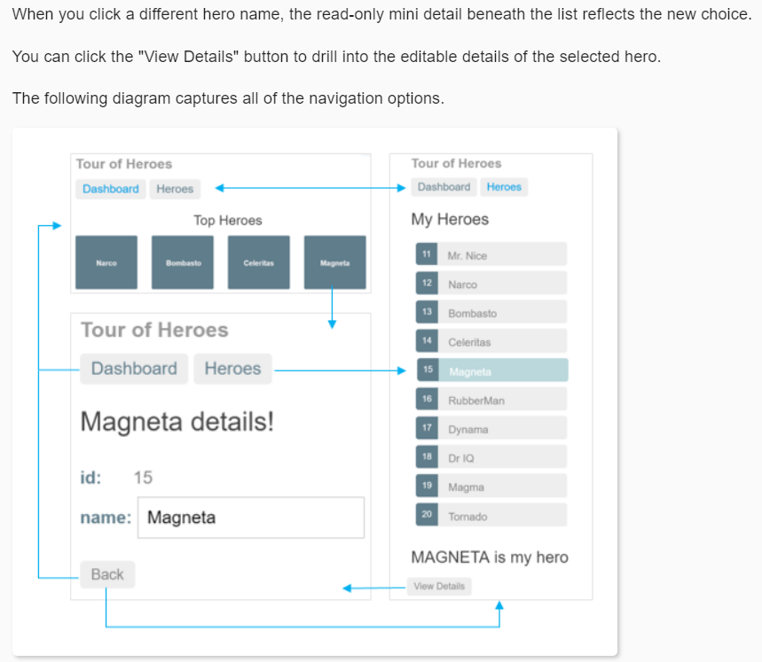
What you’ll build |||

Slide 27
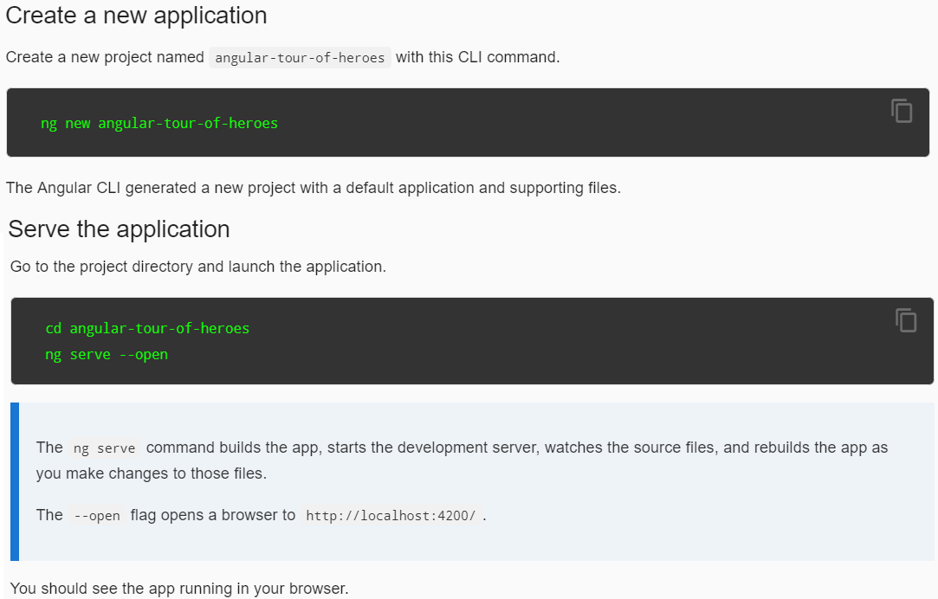
The Application Shell

Slide 28
Angular Components
The page you see is the application shell.
The shell is controlled by an Angular component named AppComponent.
Components are the fundamental building blocks of Angular applications.
They
display data on the screen
listen for user input
take action based on that input

Slide 29
Change Application Title
Open the project in your favorite editor or IDE and navigate to the src/app folder.
You'll find the implementation of the shell AppComponent distributed over three files:
app.component.ts— the component class code, written in TypeScript.
app.component.html— the component template, written in HTML.
app.component.css— the component's private CSS styles.

Slide 30
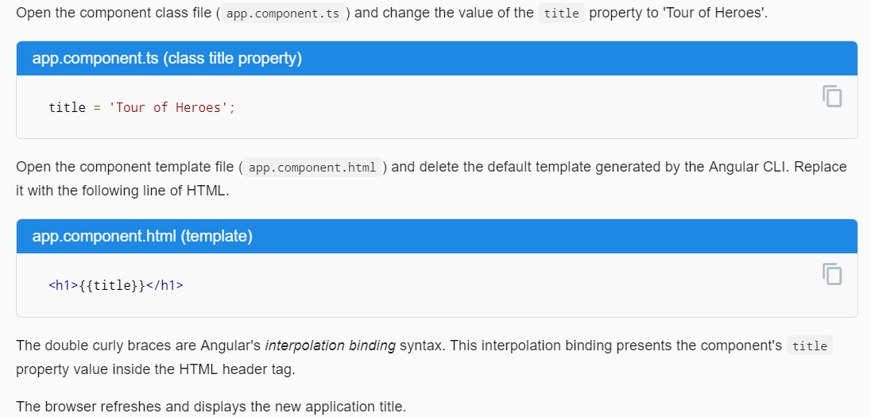
Change Application Title |

Slide 31
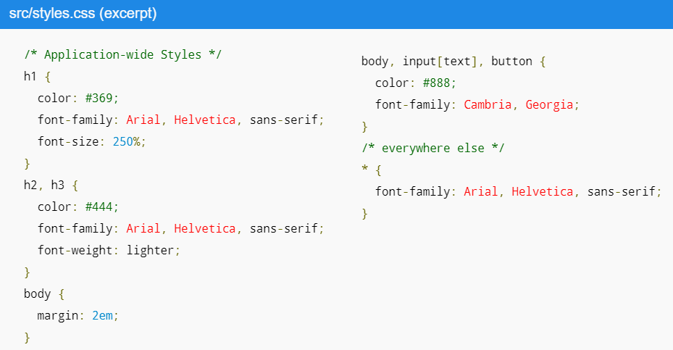
Add Application Styles
Most apps strive for a consistent look across the application.
The CLI generated an empty styles.css for this purpose.
Put your application-wide styles there.
Here's an excerpt from the styles.css for the Tour of Heroes sample app.

Slide 32
The Hero Editor
The application now has a basic title.
Next you will create a new component to display hero information and place that component in the application shell.

Slide 33
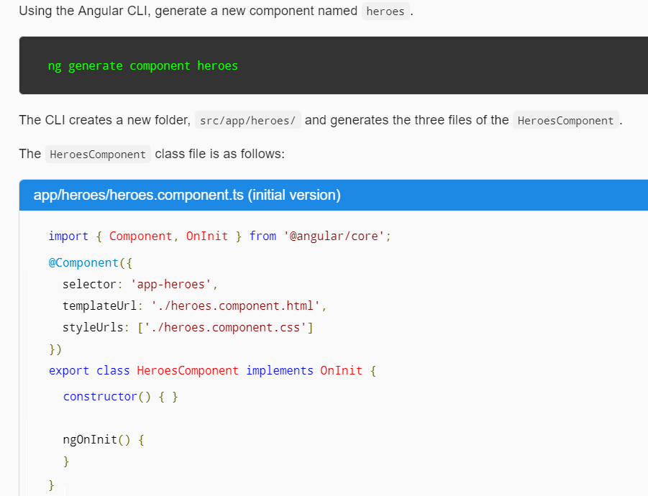
Create the heroes component
//Shortcut
ng g component heroes

Slide 34
Create the heroes component |
You always import the Component symbol from the Angular core library and annotate the component class with @Component.
@Component is a decorator function that specifies the Angular metadata for the component.
The CLI generated three metadata properties:
selector— the component's CSS element selector
templateUrl— the location of the component's template file.
styleUrls— the location of the component's private CSS styles.
The CSS element selector, 'app-heroes', matches the name of the HTML element that identifies this component within a parent component's template.
The ngOnInit is a lifecycle hook Angular calls ngOnInit shortly after creating a component.
It's a good place to put initialization logic.
Always export the component class so you can import it elsewhere ... like in the AppModule.

Slide 35
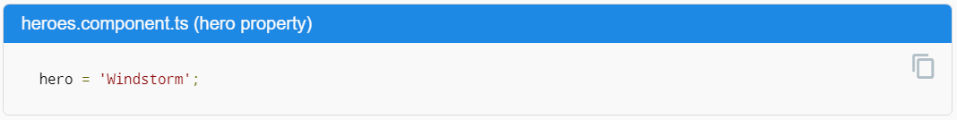
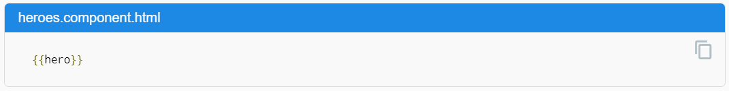
Add a hero property || Show the hero
Add a hero property to the HeroesComponent for a hero named "Windstorm.“
Open the heroes.component.html template file.
Delete the default text generated by the Angular CLI and replace it with a data binding to the new hero property.

Slide 36
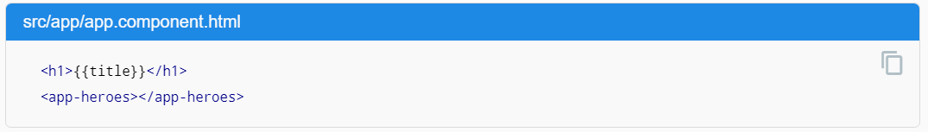
Show the HeroesComponent View
To display the HeroesComponent, you must add it to the template of the shell AppComponent.
Remember that app-heroes is the element selector for the HeroesComponent.
So add an <app-heroes> element to the AppComponent template file, just below the title.
Assuming that the CLI ng serve command is still running, the browser should refresh and display both the application title and the hero name.

Slide 37
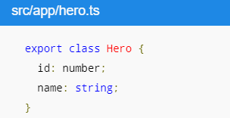
Create a Hero class
A real hero is more than a name.
Create a Hero class in its own file in the src/app folder. Give it id and name properties.
Return to the HeroesComponent class and import the Hero class.
Refactor the component's hero property to be of type Hero.
Initialize it with an id of 1 and the name Windstorm.
The revised HeroesComponent class file is shown in Fig H1.
The page no longer displays properly because you changed the hero from a string to an object.

Slide 38
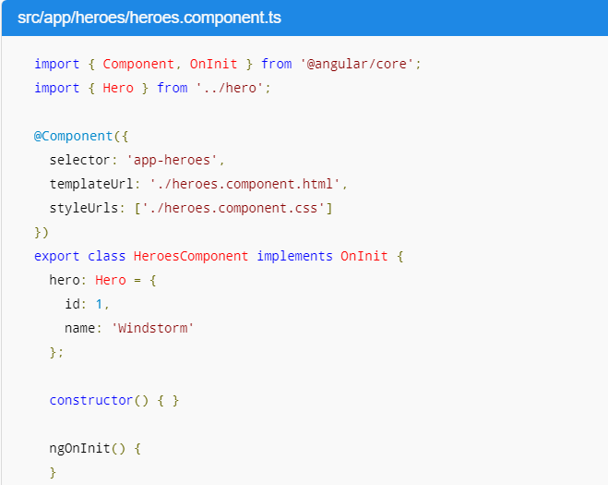
Fig H1

Slide 39
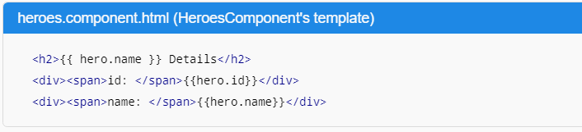
Show the Hero object
Update the binding in the template to announce the hero's name and show both id and name in a details layout like this:
The browser refreshes and display's the hero's information.

Slide 40
Format with the UppercasePipe
Modify the hero.name binding like this.
<h2>{{ hero.name | uppercase }} Details</h2>
The browser refreshes and now the hero's name is displayed in capital letters.
The word uppercase in the interpolation binding, right after the pipe operator ( | ), activates the built-in UppercasePipe.
Pipes are a good way to
format strings
currency amounts
dates and
other display data
Angular ships with several built-in pipes and you can create your own.

Slide 41
Edit the hero
Users should be able to edit the hero name in an <input> textbox.
The textbox should both display the hero's name property and update that property as the user types.
That means data flow from the component class out to the screen and from the screen back to the class.
To automate that data flow, setup a two-way data binding between the <input> form element and the hero.name property.

Slide 42
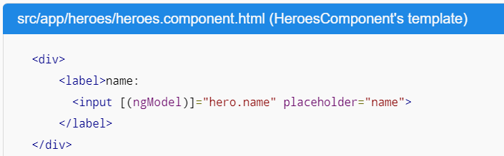
Two-way binding
Refactor the details area in the HeroesComponent template so it looks like this:
[(ngModel)] is Angular's two-way data binding syntax.
Here it binds the hero.name property to the HTML textbox so that data can flow in both directions:
from the hero.name property to the textbox
from the textbox back to the hero.name.

Slide 43

The missing FormsModule
Notice that the app stopped working when you added [(ngModel)].
To see the error, open the browser development tools and look in the console for a message like
Although ngModel is a valid Angular directive, it isn't available by default.
It belongs to the optional FormsModule and you must opt-in to using it.

Slide 44
AppModule
Angular needs to know how the pieces of your application fit together and what other files and libraries the app requires. This information is called metadata
Some of the metadata is in the @Component decorators that you added to your component classes.
Other critical metadata is in @NgModule decorators.
The most important @NgModule decorator annotates the top-level AppModule class.
The Angular CLI generated an AppModule class in src/app/app.module.ts when it created the project.
This is where you opt-in to the FormsModule.

Slide 45
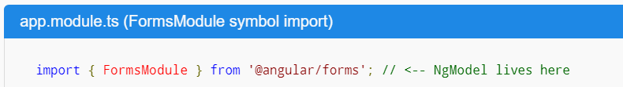
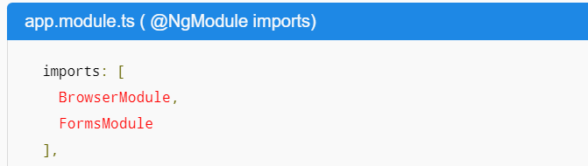
Import FormsModule
Open AppModule (app.module.ts) and import the FormsModule symbol from the @angular/forms library.
Then add FormsModule to the @NgModule metadata's imports array, which contains a list of external modules that the app needs.
When the browser refreshes, the app should work again.
You can edit the hero's name and see the changes reflected immediately in the <h2> above the textbox.

Slide 46
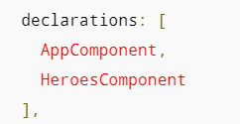
Declare HeroesComponent
Every component must be declared in exactly one NgModule.
You didn't declare the HeroesComponent. So why did the application work?
It worked because the Angular CLI declared HeroesComponent in the AppModule when it generated that component.
Open src/app/app.module.ts and find HeroesComponent imported near the top
The HeroesComponent is declared in the @NgModule.declarations array.
Note that AppModule declares both application components, AppComponent and HeroesComponent.

Slide 47
Displaying a List
In this section, you'll expand the Tour of Heroes app to
display a list of heroes
allow users to select a hero
display the hero's details
Create mock heroes
Displaying heroes
Master/Detail

Slide 48
Create Mock heroes
You'll need some heroes to display.
Eventually you'll get them from a remote data server.
For now, you'll create some mock heroes and pretend they came from the server.
Create a file called mock-heroes.ts in the src/app/ folder.
Define a HEROES constant as an array of ten heroes and export it. The file should look like Fig D1.

Slide 49
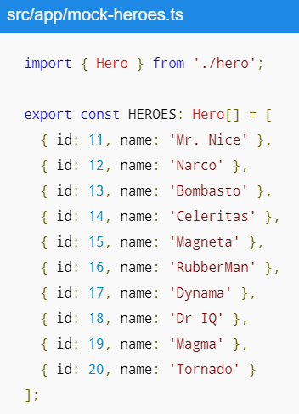
Fig D1

Slide 50
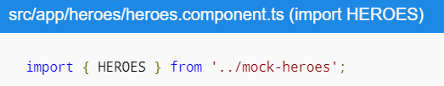

Displaying heroes
You're about to display the list of heroes at the top of the HeroesComponent.
Open the HeroesComponent class file and import the mock HEROES.
Add a heroes property to the class that exposes these heroes for binding.

Slide 51

List Heroes with *ngFor
Open the HeroesComponent template file and make the following changes:
Add an <h2> at the top
Below it add an HTML unordered list (<ul>)
Insert an <li> within the <ul> that displays properties of a hero.
Sprinkle some CSS classes for styling (you'll add the CSS styles shortly).
Make it look like Fig D2.
Now change the <li> to this:
The *ngFor is Angular's repeater directive.
It repeats the host element for each element in a list.

Slide 52
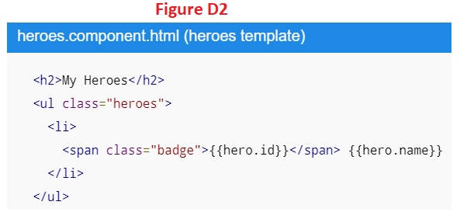
Fig D2

Slide 53
Style the heroes
The heroes list should be attractive and should respond visually when users hover over and select a hero from the list.
In the first tutorial, you set the basic styles for the entire application in styles.css. That stylesheet didn't include styles for this list of heroes.
You could add more styles to styles.css and keep growing that stylesheet as you add components.
You may prefer instead to define private styles for a specific component and keep everything a component needs— the code, the HTML, and the CSS —together in one place.
This approach makes it easier to re-use the component somewhere else and deliver the component's intended appearance even if the global styles are different.
You define private styles either inline in the @Component.styles array or as stylesheet file(s) identified in the @Component.styleUrls array.
When the CLI generated the HeroesComponent, it created an empty heroes.component.css stylesheet for the HeroesComponent and pointed to it in @Component.styleUrls like Fig D3.
Open the heroes.component.css file and paste in the private CSS styles for the HeroesComponent Fig D4.

Slide 54
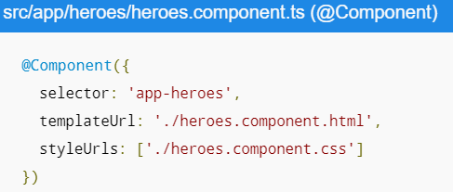
Fig D3

Slide 55
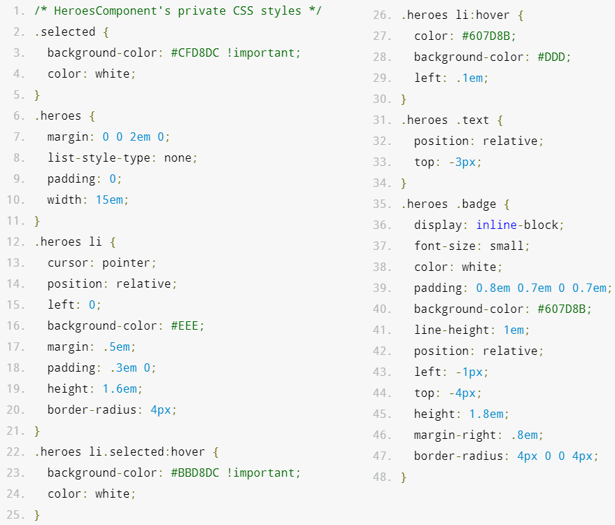
Fig D4

Slide 56
Master/Detail
When the user clicks a hero in the master list, the component should display the selected hero's details at the bottom of the page.
In this section, you'll listen for the hero item click event and update the hero detail.
Add a click event binding
Add the click event handler
Update the details template
Hide empty details with *ngIf
Style the selected hero

Slide 57

Add a click event binding
Add a click event binding to the <li> like this:
This is an example of Angular's event binding syntax.
The parentheses around click tell Angular to listen for the <li> element's click event.
When the user clicks in the <li>, Angular executes the onSelect(hero) expression.
onSelect( ) is a HeroesComponent method that you're about to write.
Angular calls it with the hero object displayed in the clicked <li>, the same hero defined previously in the *ngFor expression

Slide 58
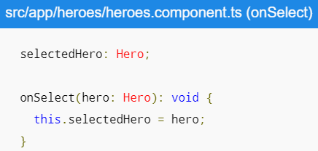
Adding the event handler
Rename the component's hero property to selectedHero but don't assign it.
There is no selected hero when the application starts.
Add the following onSelect( ) method, which assigns the clicked hero from the template to the component's selectedHero.

Slide 59
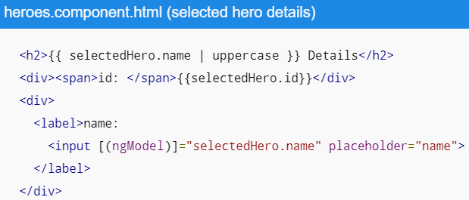
Update the details template
The template still refers to the component's old hero property which no longer exists. Rename hero to selectedHero.

Slide 60
Hide empty details with *ngIf
After the browser refreshes, the application is broken.
Open the browser developer tools and look in the console for an error message like this:
Now click one of the list items. The app seems to be working again.
The heroes appear in a list and details about the clicked hero appear at the bottom of the page.

Slide 61
What Happened?
When the app starts, the selectedHero is undefined by design.
Binding expressions in the template that refer to properties of selectedHero — expressions like {{selectedHero.name}} — must fail because there is no selected hero.

Slide 62
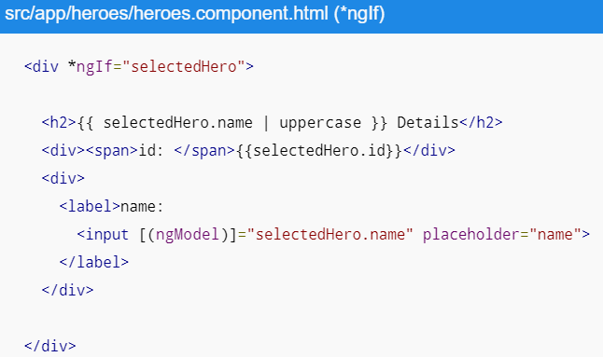
The Fix
The component should only display the selected hero details if the selectedHero exists.
Wrap the hero detail HTML in a <div>.
Add Angular's *ngIf directive to the <div> and set it to selectedHero.
After the browser refreshes, the list of names reappears.
The details area is blank. Click a hero and its details appear.

Slide 63
Why it works?
When selectedHero is undefined, the ngIf removes the hero detail from the DOM.
There are no selectedHero bindings to worry about.
When the user picks a hero, selectedHero has a value and ngIf puts the hero detail into the DOM.

Slide 64
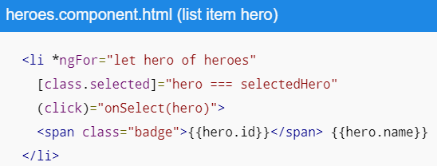
Style the selected hero
It's difficult to identify the selected hero in the list when all <li> elements look alike.
If the user clicks "Magneta", that hero should render with a distinctive but subtle background color.
That selected hero coloring is the work of the .selected CSS class in the styles you added earlier.
You just have to apply the .selected class to the <li> when the user clicks it.
The Angular class binding makes it easy to add and remove a CSS class conditionally.
Add the following [class.selected] binding to the <li> in the HeroesComponent template:

Slide 65
Master/Detail Components

Slide 66
Services

Slide 67
Routing

Slide 68
HTTP

Slide 69
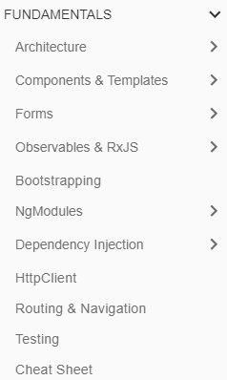
3
Fundamentals

Slide 70
Architecture
In this section, we will dive into the following topics:
Architecture overview
Intro to Modules
Intro to Components
Intro to Services and DI
Next Steps: tools and techniques

Slide 71
Architecture overview
Angular is a platform and framework for building client applications in HTML and TypeScript.
Angular is itself written in TypeScript. It implements core and optional functionality as a set of TypeScript libraries that you import into your apps.
The basic building blocks of an Angular application are NgModules, which provide a compilation context for components.
NgModules collect related code into functional sets; an Angular app is defined by a set of NgModules.
An app always has at least a root module that enables bootstrapping, and typically has many more feature modules.
Components define views, which are sets of screen elements that Angular can choose among and modify according to your program logic and data.
Every app has at least a root component.
Components use services, which provide specific functionality not directly related to views.
Service providers can be injected into components as dependencies, making your code modular, reusable, and efficient.

Slide 72
Architecture overview |
Both components and services are simply classes, with decorators that mark their type and provide metadata that tells Angular how to use them.
The metadata for a component class associates it with a template that defines a view.
A template combines ordinary HTML with Angular directives and binding markup that allow Angular to modify the HTML before rendering it for display.
The metadata for a service class provides the information Angular needs to make it available to components through Dependency Injection (DI).
An app's components typically define many views, arranged hierarchically.
Angular provides the Router service to help you define navigation paths among views.
The router provides sophisticated in-browser navigational capabilities.

Slide 73
Modules
Angular defines the NgModule, which differs from and complements the JavaScript (ES2015) module.
An NgModule declares a compilation context for a set of components that is dedicated to an application domain, a workflow, or a closely related set of capabilities.
An NgModule can associate its components with related code, such as services, to form functional units.
Every Angular app has a root module, conventionally named AppModule, which provides the bootstrap mechanism that launches the application.
An app typically contains many functional modules.
Like JavaScript modules, NgModules can import functionality from other NgModules, and allow their own functionality to be exported and used by other NgModules.
For example, to use the router service in your app, you import the Router NgModule.
Organizing your code into distinct functional modules helps in managing development of complex applications, and in designing for reusability.
In addition, this technique lets you take advantage of lazy-loading—that is, loading modules on demand—in order to minimize the amount of code that needs to be loaded at startup.

Slide 74
Components
Every Angular application has at least one component, the root component that connects a component hierarchy with the page DOM.
Each component defines a class that contains application data and logic, and is associated with an HTML template that defines a view to be displayed in a target environment.
The @Component decorator identifies the class immediately below it as a component, and provides the template and related component-specific metadata.
Decorators are functions that modify JavaScript classes.
Angular defines a number of such decorators that attach specific kinds of metadata to classes, so that it knows what those classes mean and how they should work.

Slide 75
Templates, directives, and data binding
A template combines HTML with Angular markup that can modify the HTML elements before they are displayed.
Template directives provide program logic, and binding markup connects your application data and the document object model (DOM).
Event binding lets your app respond to user input in the target environment by updating your application data.
Property binding lets you interpolate values that are computed from your application data into the HTML.
Before a view is displayed, Angular evaluates the directives and resolves the binding syntax in the template to modify the HTML elements and the DOM, according to your program data and logic.
Angular supports two-way data binding, meaning that changes in the DOM, such as user choices, can also be reflected back into your program data.
Your templates can also use pipes to improve the user experience by transforming values for display.
Use pipes to display, for example, dates and currency values in a way appropriate to the user's locale.
Angular provides predefined pipes for common transformations, and you can also define your own.

Slide 76
Services and dependency injection
For data or logic that is not associated with a specific view, and that you want to share across components, you create a service class.
A service class definition is immediately preceded by the @Injectable decorator.
The decorator provides the metadata that allows your service to be injected into client components as a dependency.
Dependency injection (or DI) lets you keep your component classes lean and efficient.
They don't fetch data from the server, validate user input, or log directly to the console; they delegate such tasks to services.

Slide 77
Routing
The Angular Router NgModule provides a service that lets you define a navigation path among the different application states and view hierarchies in your app.
It is modeled on the familiar browser navigation conventions:
Enter a URL in the address bar and the browser navigates to a corresponding page.
Click links on the page and the browser navigates to a new page.
Click the browser's back and forward buttons and the browser navigates backward and forward through the history of pages you've seen.
The router maps URL-like paths to views instead of pages.
When a user performs an action, such as clicking a link, that would load a new page in the browser, the router intercepts the browser's behavior, and shows or hides view hierarchies.
If the router determines that the current application state requires particular functionality, and the module that defines it has not been loaded, the router can lazy-load the module on demand.
The router interprets a link URL according to your app's view navigation rules and data state.
You can navigate to new views when the user clicks a button, selects from a drop box, or in response to some other stimulus from any source.
The Router logs activity in the browser's history journal, so the back and forward buttons work as well.

Slide 78
Routing |
To define navigation rules, you associate navigation paths with your components.
A path uses a URL-like syntax that integrates your program data, in much the same way that template syntax integrates your views with your program data.
You can then apply program logic to choose which views to show or to hide, in response to user input and your own access rules.

Slide 79
What’s next
You've learned the basics about the main building blocks of an Angular application.
The Figure A-1 shows how these basic pieces are related.
Together, a component and template define an Angular view.
A decorator on a component class adds the metadata, including a pointer to the associated template.
Directives and binding markup in a component's template modify views based on program data and logic.
The dependency injector provides services to a component, such as the router service that lets you define navigation among views.

Slide 80
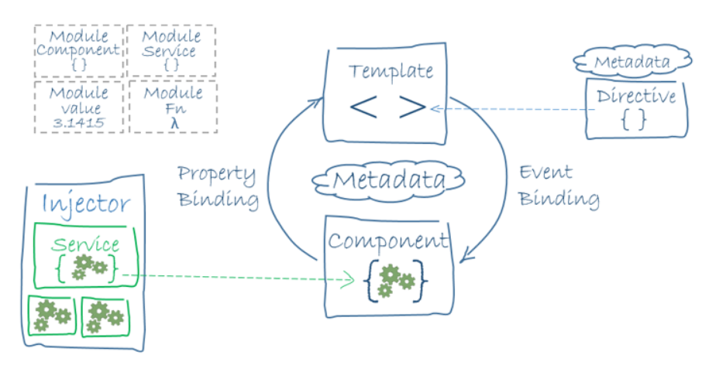
Figure A-1

Slide 81
Intro to Modules
Angular apps are modular and Angular has its own modularity system called NgModules.
An NgModule is a container for a cohesive block of code dedicated to an application domain, a workflow, or a closely related set of capabilities.
It can contain components, service providers, and other code files whose scope is defined by the containing NgModule.
It can import functionality that is exported from other NgModules, and export selected functionality for use by other NgModules.
Every Angular app has at least one NgModule class, the root module, which is conventionally named AppModule and resides in a file named app.module.ts.
You launch your app by bootstrapping the root NgModule.
While a small application might have only one NgModule, most apps have many more feature modules.
The root NgModule for an app is so named because it can include child NgModules in a hierarchy of any depth.

Slide 82
NgModule metadata
https://angular.io/guide/architecture-modules

Slide 83
Intro to Components

Slide 84
Intro to Services and DI

Slide 85
Next Steps: tools and techniques

Slide 86
Components & Templates

Slide 87
Forms

Slide 88
Observables & RxJS

Slide 89
Bootstrapping

Slide 90
NgModules

Slide 91
Dependency Injection

Slide 92
HttpClient

Slide 93
Routing & Navigation

Slide 94
Testing

Slide 95
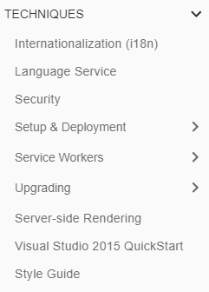
4
Techniques

Slide 96
Angular Development History

Slide 97
Angular Development History
AngularJS was originally developed in 2009 by Miško Hevery at Brat Tech LLC as the software behind an online JSON storage service, that would have been priced by the megabyte, for easy-to-make applications for the enterprise.
This venture was located at the web domain "GetAngular.com", and had a few subscribers, before the two decided to abandon the business idea and release Angular as an open-source library.
The 1.6 release added many of the concepts of Angular to AngularJS, including the concept of a component-based application architecture.
This release among others removed the Sandbox, which many developers believed provided additional security, despite numerous vulnerabilities that had been discovered that bypassed the sandbox.
The current (as of February 2018) stable release of AngularJS is 1.6.9.
In January 2018, a schedule was announced for phasing-out AngularJS: after releasing 1.7.0, the active development on AngularJS will continue till June 30, 2018.
Afterwards, 1.7 will be supported till June 30, 2021 as long-term support.

Slide 98
Angular and AngularDart
Angular 2+ versions are simply called Angular.
Angular is an incompatible rewrite of AngularJS.
It is a TypeScript-based open-source front-end web application platform.
Angular 4 was announced on 13 December 2016, skipping 3 to avoid a confusion due to the misalignment of the router package's version which was already distributed as v3.3.0.
AngularDart works on Dart, which is an object-oriented, class defined, single inheritance using C# style syntax, that is different from Angular JS (which uses JavaScript) and Angular 2/ Angular 4 (which uses TypeScript).
Angular 4 released in March 2017, with the framework's version aligned with the version number of the router it used.
Angular 5 was released on November 1, 2017. Key improvements in Angular 5 include support for progressive Web apps, a build optimizer and improvements related to Material Design
Angular 6 release will be pushed back to March or April 2018, with Angular 7 showing up in September/October 2018.
Each version is expected to be backward-compatible with the prior release. Google pledged to do twice-a-year upgrades.
As on: 7 Apr 18

